Slide 1

Keyword-aware Abstractive Summarization by Extracting Set-level Intermediate Summaries
Yizhu Liu, Qi Jia, Kenny Q. Zhu
Shanghai Jiao Tong University, Shanghai, China

Slide 2
Task Description
Abstractive Summarization
Document
new delhi, india police have arrested four employees. federal education minister smriti irani was visiting a fabindia outlet in the tourist resort state of goa on friday when she discovered a surveillance camera pointed at the store ’s changing room. four employees of the store have been arrested , but its manager was still at large saturday . state authorities found an overhead camera that the minister had spotted and determined that it was indeed able to take photos of customers. authorities sealed off the store and summoned six top officials from fabindia. the arrested staff have been charged with voyeurism and breach of privacy . if convicted , they could spend up to three years in jail .
Summary
federal education minister smriti irani visited a fabindia store in goa , saw cameras.
authoroities discovered the cameras could capture photos from the store ’s changing room.
the four store workers arrested could spend three years each in prison if convicted .
Notes:
In this paper, we focus on abstractive summarization,
It is the task of creating a short, accurate, and informative summary from a long text document
without using the sentences of the document.
We found that the summary is always

Slide 3
Task Description
Abstractive Summarization
Document
new delhi, india police have arrested four employees. federal education minister smriti irani was visiting a fabindia outlet in the tourist resort state of goa on friday when she discovered a surveillance camera pointed at the store ’s changing room. four employees of the store have been arrested , but its manager was still at large saturday . state authorities found an overhead camera that the minister had spotted and determined that it was indeed able to take photos of customers. authorities sealed off the store and summoned six top officials from fabindia. the arrested staff have been charged with voyeurism and breach of privacy . if convicted , they could spend up to three years in jail .
Summary
federal education minister smriti irani visited a fabindia store in goa , saw cameras.
authoroities discovered the cameras could capture photos from the store ’s changing room.
the four store workers arrested could spend three years each in prison if convicted .
Notes:
the rewriting of the salient sentences of the source document,
and contains the keywords of these sentences.

Slide 4
Motivation
Sequence-to-sequence Model with Attention Mechanism
Enhance the alignment between encoder (source documents) and decoder (summaries)
Notes:
As we known, the most popular approach used in summarization tasks is sequence to sequence model with attention mechanism,
which learns the alignment between the inputs of encoder and decoder.
To improve the effectiveness of seq2seq model in summarization, we should enhance the alignment between encoder and decoder

Slide 5
Motivation
Enhance the alignment between source documents and summaries
Extractor-Abstractor Framework
First select the salient content of the source documents
Source Documents
Salient content
Extractor
Notes:
We adopt the Extractor-Abstractor framework in this paper.
which first uses an extractor to select the salient content from the source document.

Slide 6
Motivation
Enhance the alignment between source documents and summaries
Extractor-Abstractor Framework
First select the salient content of the source documents
2. Paraphrase the selected content to generate a summary
Source Documents
Salient content
Summaries
Extractor
Abstractor
Notes:
and then use abstractor to paraphrase the selected content to generate the final summary

Slide 7
Approach—Extractor-Abstractor Framework
Create Pseudo Summaries for training
Create Pseudo Summaries for training
Keywords can help select salient content
Summaries
Salient content
Summaries
Source Documents
Salient content
Source Documents
Extractor
Extractor
Abstractor
Abstractor
Notes:
To train this framework, we should first create the intermediate result, named pseudo summaries.
The pseudo summaries is the salient content extracted from the source document.
Keywords can help select salient content

Slide 8
Previous work — Pseudo Summaries
Sentence-level (Chen and Bansal, 2018)
Summary-level (Sharma et al., 2019)
Document
new delhi, india police have arrested four employees. federal education minister smriti irani was visiting a fabindia outlet in the tourist resort state of goa on friday when she discovered a surveillance camera pointed at the store ’s changing room. four employees of the store have been arrested , but its manager was still at large saturday . state authorities found an overhead camera that the minister had spotted and determined that it was indeed able to take photos of customers. authorities sealed off the store and summoned six top officials from fabindia. the arrested staff have been charged with voyeurism and breach of privacy . if convicted , they could spend up to three years in jail .
Summary
federal education minister smriti irani visited a fabindia store in goa , saw cameras.
authoroities discovered the cameras could capture photos from the store ’s changing room.
the four store workers arrested could spend three years each in prison if convicted .

Slide 9
Previous work — Pseudo Summaries
Sentence-level (Chen and Bansal, 2018)
Summary-level (Sharma et al., 2019)
Notes:
Previously, There are two ways for creating pseudo summaries
sentence-level matching heuristics and summary level heuristics

Slide 10
Previous work — Pseudo Summaries
Sentence-level (Chen and Bansal, 2018)
Pseudo Summary
federal education minister smriti irani was visiting a fabindia outlet in the tourist resort state of goa on friday when she discovered a surveillance camera pointed at the store ’s changing room.
state authorities found an overhead camera that the minister had spotted and determined that it was indeed able to take photos of customers.
if convicted , they could spend up to three years in jail .
Summary
federal education minister smriti irani visited a fabindia store in goa , saw cameras.
authoroities discovered the cameras could capture photos from the store ’s changing room.
the four store workers arrested could spend three years each in prison if convicted .
The sentence in summary may be summarized from multiple sentences.
Notes:
sentence-level heuristics extracts one sentence from the source document with the maximum similarity for each reference sentence.
However, the fact is that the sentence in summary may be summarized from multiple sentences of source document.
The sentences in pseudo summary and reference summary are one-to-one aligned.
So Sentence-level pseudo summary will lose some information of reference summary, such as
the “the four workers are arrested” in this example.

Slide 11
Previous work — Pseudo Summaries
Summary-level (Sharma et al., 2019)
Pseudo Summary
Pseudo Summary
federal education minister smriti irani was visiting a fabindia outlet in the tourist resort state of goa on friday when she discovered a surveillance camera pointed at the store ’s changing room.
if convicted , they could spend up to three years in jail .
Summary
Summary
federal education minister smriti irani visited a fabindia store in goa , saw cameras. authoroities discovered the cameras could capture photos from the store ’s changing room. the four store workers arrested could spend three years each in prison if convicted .
Notes:
summary-level heuristics selects the best combination of the sentences from source document that maximizes the similarity with reference summary.
this method treat every token equally in computing the similarity score.
So the pseudo summaries always ignore the keywords.

Slide 12
Previous work — Pseudo Summaries
Summary-level (Sharma et al., 2019)
Pseudo Summary
Pseudo Summary
federal education minister smriti irani was visiting a fabindia outlet in the tourist resort state of goa on friday when she discovered a surveillance camera pointed at the store ’s changing room.
if convicted , they could spend up to three years in jail .
Summary
Summary
federal education minister smriti irani visited a fabindia store in goa , saw cameras. authoroities discovered the cameras could capture photos from the store ’s changing room. the four store workers arrested could spend three years each in prison if convicted .
The importance of each word in source documents and summaries is different.
Notes:
In this example, the red part of summary is not covered by pseudo summary.
.

Slide 13
Approach—Set-level Matching Heuristics
Data Pre-processing: Create the set-level pseudo summaries based on keywords
Source Document D
Reference Summary R
d₀
r₀
Set-level Matching Heuristics
d₁
r₁
d₂
r₂
……
d_{N}
Notes:
To solve above problems, we proposed a Set-level Matching Heuristics to create set-level pseudo summaries based on keywords.

Slide 14
Approach—Set-level Matching Heuristics
Source Document D
Reference Summary R
d₀
r₀
d₁
r₁
d₂
……
r₂
d_{N}
Notes:
given a source document and its reference summary

Slide 15
Approach—Set-level Matching Heuristics
Source Document D
Reference Summary R
d₀
r₀
Maximum
ROUGE
d₁
r₁
d₂
r₂
……
Maximum
Keywords overlap
d_{N}
Select
Aligned
Set 1
d₂
Set-level Pseudo Summary P
Notes:
The set-level heuristics first selects a best combination of sentences from source document that maximizes the ROUGE scores and keywords overlapping with each sentence in reference summary.
Suppose the selected sentence set for r_0 is Set 1, including source sentence d_2.

Slide 16
Approach—Set-level Matching Heuristics
Source Document D
Reference Summary R
d₀
Maximum
ROUGE
d₁
r₁
d₂
r₂
……
Maximum
Keywords overlap
d_{N}
Select
Aligned
Set 1
d₂
r₀
d₂
Set 2
d₅
Notes:
the selected sentence set for r_1 is the set 2, including d_2 and d_5.
Set 1 and Set 2 overlap.

Slide 17
Approach—Set-level Matching Heuristics
Source Document D
Reference Summary R
d₀
Maximum
ROUGE
d₁
d₂
r₂
……
Maximum
Keywords overlap
d_{N}
Select
Reorganize
Reorganize
Aligned
d₂
r₀
d₂
Set 1
Set 1
d₅
r₁
Notes:
so we respectively merge them and their corresponding reference sentence.

Slide 18

Approach—Set-level Matching Heuristics
Source Document D
Reference Summary R
d₀
r₀
Maximum
ROUGE
d₁
r₁
d₂
……
Maximum
Keywords overlap
r₂
d_{N}
Select
Reorganize
Reorganize
Aligned
d₂
r₀
d₂
Set 1
Set 1
d₅
r₁
Set 2
d₃
r₂
Set 2
d₇
Set-level Pseudo Summary P
Set-level Reference Summary $\hat{R}$
Notes:
In this way, we can get set-level pseudo summary and its set-level reference summary,

Slide 19
Approach—Set-level Matching Heuristics
Pseudo Summary
Set 1. federal education minister smriti irani was visiting a fabindia outlet in the tourist resort
state of goa on friday when she discovered a surveillance camera pointed at the store ’s
changing room. state authorities found an overhead camera that the minister had spotted
and determined that it was indeed able to take photos of customers.
Set 2. four employees of the store have been arrested . if convicted , they could spend up to three
years in jail .
Summary
Set 1. federal education minister smriti irani visited a fabindia store in goa , saw cameras.
authoroities discovered the cameras could capture photos from the store ’s changing room.
Set 2. the four store workers arrested could spend three years each in prison if convicted .
Notes:
like this.
The sentence sets in pseudo summary is aligned to the sentence set in reference summary

Slide 20
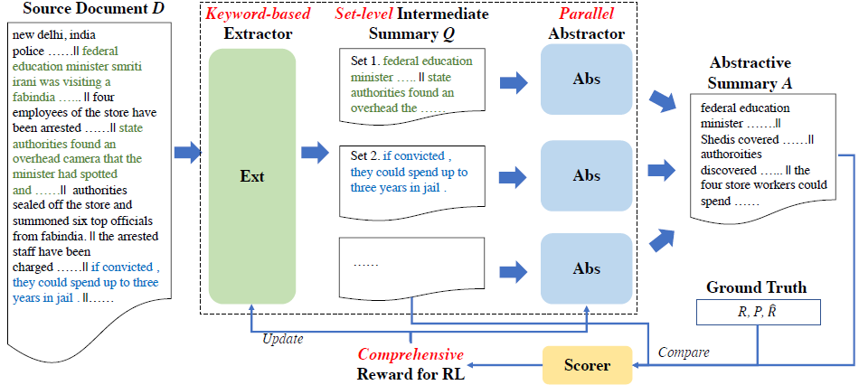
Approach—Extractor-Abstractor Model
Connect Extractor and Abstractor together
Make Extractor-Abstractor Framework an end-to-end trainable model.

Slide 21
Approach—Proposed Extractor-Abstractor
Source Documents
Salient content
Summaries
Extractor
Abstractor
Set-level Intermediate Summaries
Source Documents
Keyword-based extractor
Set₁
Set₂
……
Set_{m}
#11
Notes:
As our set-level intermediate summaries are created by keywords.
So we propose a Keyword-based extractor to extract sets of sentences from the source document.

Slide 22
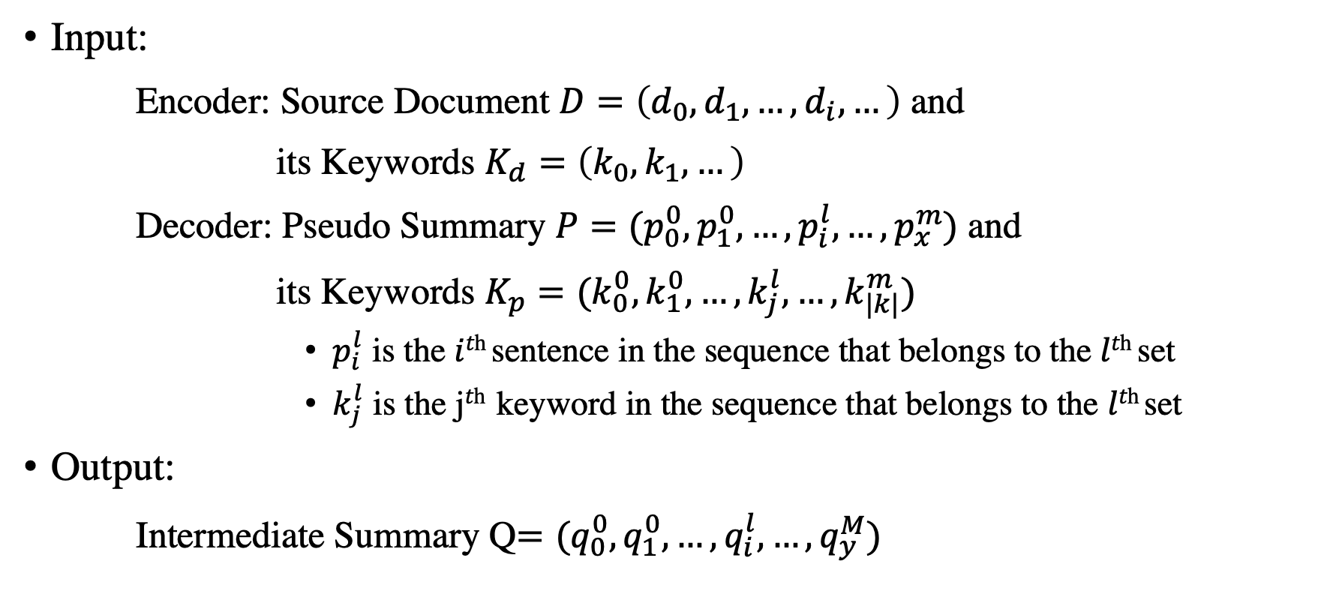
Approach—Keyword-based Extractor
Input:
Encoder: Source Document $D=\left(d_{0},d_{1},…,d_{i},…\right)$ and
its Keywords $K_{d}=\left(k_{0},k_{1},…\right)$
Decoder: Pseudo Summary $P=(p_{0}^{0},p_{1}^{0},…,p_{i}^{l},…,p_{x}^{m})$ and
its Keywords $K_{p}=(k_{0}^{0},k_{1}^{0},…,k_{j}^{l},…,k_{|k|}^{m})$
$p_{i}^{l}$ is the 𝑖^{𝑡h} sentence in the sequence that belongs to the 𝑙^{𝑡h} set
$k_{j}^{l}$ is the j^{𝑡h} keyword in the sequence that belongs to the 𝑙^{𝑡h} set
Output:
Intermediate Summary Q$=(q_{0}^{0},q_{1}^{0},…,q_{i}^{l},…,q_{y}^{M})$

Slide 23
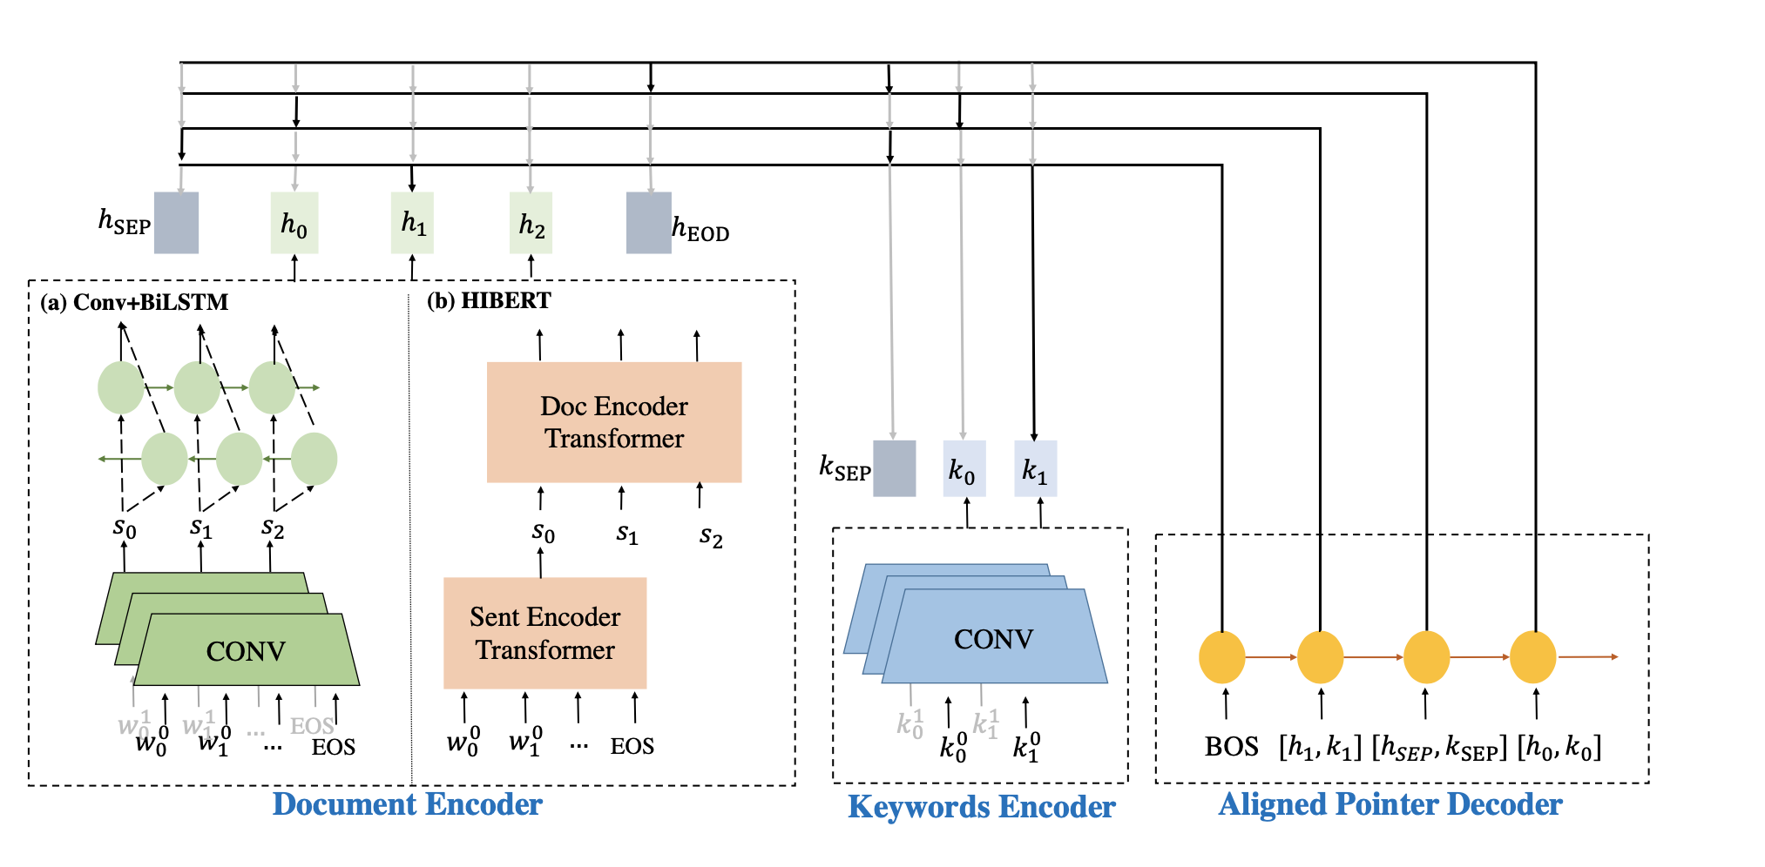






Approach—Keyword-based Extractor
Document Encoder
$${Sent}_{1}$$
$${Sent}_{2}$$
$${Sent}_{3}$$
Sentence Encoder
$$w_{1}^{}$$
$$w_{2}^{}$$
$$…$$
EOS
Document Encoder with/without Pretrained Model
Document Encoder
#12
Notes:
The keyword-based extractor consists of document encoder, keywords encoder and aligned pointer decoder.
We can take non-pretrained model and pretrained model as document encoder

Slide 24
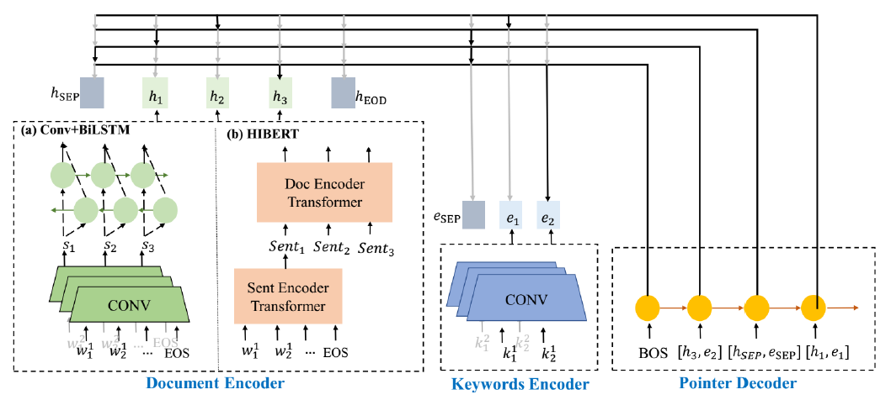
Approach—Keyword-based Extractor
Conv: sentence representation from words
Document Encoder without Pretrained mddel
BiLSTM: content-ware sentence representation
#13
Notes:
In our work, without pretrained model, we use the convoluational neural network for sentence representation
and Bi directional LSTM for content-ware sentence representation.

Slide 25
Approach—Keyword-based Extractor
Document Encoder with pretrained model: HIBERT
Hierarchical Transformer
#14
Notes:
With pretrained model, we use HIBERT to represent sentences. HIBERT is a pretrained hierarchical transformer.

Slide 26
Approach—Keyword-based Extractor
Document Encoder
$${Sent}_{1}$$
$${Sent}_{2}$$
$${Sent}_{3}$$
Sentence Encoder
$$w_{1}^{}$$
$$w_{2}^{}$$
$$…$$
EOS
Document Encoder
Select sentence with keywords
#15
Notes:
For keywords encoder, we encode the keywords in source document

Slide 27
Approach—Keyword-based Extractor
SEP
Document Encoder
SEP
$${Sent}_{1}$$
$${Sent}_{2}$$
$${Sent}_{3}$$
Sentence Encoder
$$w_{1}^{}$$
$$w_{2}^{}$$
$$…$$
EOS
Use a special placeholder SEP to separate sentence sets
Document Encoder
#16
Notes:
As for the aligned pointer decoder, it points to the sentences and the keywords of the input with highest probability.
The pointed sentences and keywords are consistent with pseudo summary.
this can guide the model to select the input sentences with keywords.
We use SEP to separate sentence sets, so the decoder points to the SEP means that the selection of current sentence set is finished.

Slide 28
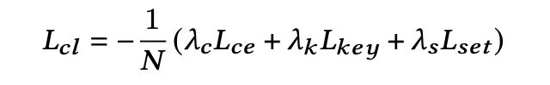
Approach—Keyword-based Extractor
Combinatorial loss
Normal cross entropy loss
Keywords loss
Set loss: <SEP> position
Notes:
Besides, we design a combinatorial loss, which is the weighted sum of cross entropy loss, keywords loss and set loss.

Slide 29
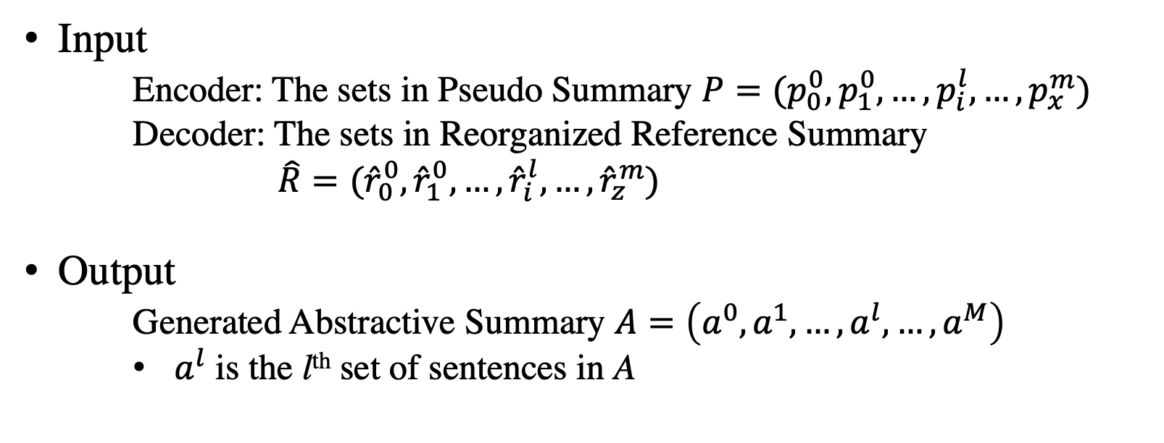
Approach—Abstractor (Seq2seq Model)
Input
Encoder: The sets in Pseudo Summary $P=(p_{0}^{0},p_{1}^{0},…,p_{i}^{l},…,p_{x}^{m})$
Decoder: The sets in Reorganized Reference Summary
$\hat{R}=({\hat{r}}_{0}^{0},{\hat{r}}_{1}^{0},…,{\hat{r}}_{i}^{l},…,{\hat{r}}_{z}^{m})$
Output
Generated Abstractive Summary $A=\left(a^{0},a^{1},…,a^{l},…,a^{M}\right)$
$a^{l}$ is the l^{th} set of sentences in A
Notes:
Sequence-to-sequence model
Paraphrase the selected content, the input of abstractor is the output of extractor

Slide 30
Approach—Proposed Extractor-Abstractor
Source Documents
Salient content
Summaries
Extractor
Abstractor
Set-level Intermediate Summaries
Source Documents
Keyword-based extractor
Set₁
Abstractor
Summaries
Set₂
Abstractor
……
……
Set_{m}
Abstractor
Parallel
Abstractor
#17
Notes:
For one document, there are multiple sentence sets extracted by extractor, so we can summarize these sentence sets by abstractor in parallel.
this can reduce the training time and memory usage of the model.

Slide 31



Approach—Abstractor (Seq2seq Model)
Abstractor w/o pretrained model: Pointer Generator (See et al., 2017)
Abstractor with pretrained model: BART (Lewis et al., 2020)
$$A$$
Special loss
consider all of the sets in a complete summary.
Encoder
Decoder
$$P$$
$$\hat{R}$$
#18
Notes:
For abstractor, we take Pointer Generator as non-pretrained abstractor and BART as pretrained abstractor.
In addition, we use special loss for the parallel abstractor, which considers all of the sets in a complete summary at training.

Slide 32
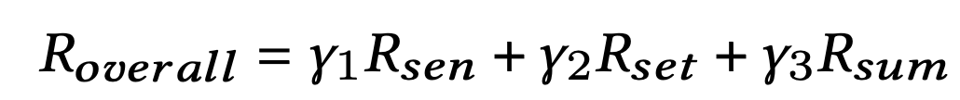

Approach—Reinforcement Learning
Comprehensive RL
Sentence-level Reward ($R_{sen}$):
ROUGE-L F1
Set-level Reward ($R_{set}$):
ROUGE-2 Recall
Summary-level Reward ($R_{sum}$):
ROUGE-2 F1

Slide 33
Approach—Proposed Extractor-Abstractor
Source Documents
Keyword-based extractor
Set₁
Abstractor
Summaries
Set₂
Abstractor
……
……
Set_{m}
Abstractor
Set-level
Intermediate Summaries
Parallel
Abstractor
Compared with
Update
Ground-Truth
RL
Comprehensive Reward
#19
Notes:
Finally, we use Reinforcement learning with proposed comprehensive reward to bridge our extractor and abstractor.

Slide 34
Approach—Reinforcement Learning
Comprehensive RL
Sentence-level reward
Set-level reward
Summary-level reward
ROUGE score between
pseudo summaries and intermediate summaries
ROUGE score between
ground-truth and final generated summaries
#20
Notes:
The comprehensive reward is the weighted sum of sentence-level, set-level and summary-level reward.
the sentence-level and set-level reward is the ROUGE score between pseudo summary and intermediate summary
The summary-level reward is the ROUGE scores between ground-truth and final generated summary.

Slide 35
Experiment
Datasets
CNN/Daily Mail (CNNDM) (Hermann et al, 2015)
Web-TLDR-17 Corpus (Web17) (Völske et al, 2017)
Webis-Snippet-20 Corpus (Web20) (Chen et al, 2020)
WikiHow Corpus (Wiki) (Koupaee and wang, 2018)
DUC-2002 (DUC)
Test set. We use the models trained on CNNDM to do the test on DUC, which can evaluate the generalizability of the models.
Notes:
In our experiment, we test our proposed extractor-abstractor framework on 5 datasets.
DUC is only used for testing.
We use the models trained on CNNDM to do the test on DUC. This can evaluate the generalization ability of the model.

Slide 36
Experiment
Compared Models
Existing Models
PN (Chen and Bansal, 2018): Extractive model without pretrained model
HIBERT (Zhang et al., 2019): Pretrained extractive model
PG (Pointer Generator) (See et al., 2017): Seq2seq model without pretrained model
FastAbs (Chen and Bansal, 2018): Extractor-Abstractor without pretrained model
BART (Lewis et al., 2020): The state-of-the-art pretrained abstractive model
Extractive
Abstractive
Notes:
We compared our best models with 5 typical existing models.
PN and HIBERT is used in extractive summarization.
Pointer Generator, FastAbs and BART is used in abstractive summarization.

Slide 37
Experiment
Compared Models
Our Proposed Models
Abstractor: PG_{sl}, BART_{sl}
Extractor: KE_{cl} (non-pretrained document encoder)
KE_{HIcl} (pretrained document encoder)
Extractor-Abstractor: RL_{sen} (sentence-level reward)
RL_{sum} (summary-level reward)
CRL (comprehensive reward)
Notes:
As our proposed extractor-abstractor framework is composed of different part.
we compared our models according to different components.
For abstractor, the models with SL denote that these models use special loss during training.
For extractor, Kecl is the keyword-based extractor without pretrained document encoder, and KE HICl is the keyword-based extractor with pretrained document encoder
For extractor-abstractor model, the Rlsent Rlsum and CRL respectively denote the RL use sentence-level reward, summary-level reward and comprehensive reward,.

Slide 38
Experiment
Evaluation Metrics
ROUGE scores: R-1, R-2, R-L
Human Evaluation (3 human annotators, 100 samples from each dataset)
Manual Alignment Accuracy (manAlign): pseudo summaries
Keyword Coverage (KC): keywords in generated summaries
Readability (Read): logical consistency and informativeness of generated summaries
Notes:
For evaluation metrics, we take ROUGE scores as our sutomatic evaluation metric.
Besides, we propose 3 human evaluation metrics.
For manual alignment accuracy, we score sentence-level, summary-level and set-level pseudo summaries
based on the alignment between pseudo summaries and its corresponding reference summary.
Keyword Coverage reflects the accuracy of keywords in generated summary with respect to reference summary.
Readability reflects the the informativeness of generated summaries and the logical consistency of generated summaries and source document.

Slide 39
Experiment
Pseudo Summaries
Extractor
Abstractor
Extractor-Abstractor
Speed and Memory
Notes:
We will evaluate our model according to these 5 aspects.

Slide 40
Experiment—Pseudo Summaries
Notes:
to evaluate our proposed keyword-based set-level pseudo summaries. we use manalign scores.
The manAlign scores of set-level pseudo summaries are the best on all datasets shows that the set-level pseudo summaries are more aligned to reference summaries.

Slide 41
Experiment—Pseudo Summaries
Abstractor
During training
Input: Pseudo Summaries
Output: Reference Summaries
During testing
Input: Pseudo Summaries
Output: Generated Summaries
Sentence-level/Summary-level/Set-level
Notes:
In addition, to compare the abstractors trained on pseudo summaries in different type, we respectively train and test the abstractor on sentence-level, summary-level and set-level pseudo summaries.

Slide 42
Experiment—Pseudo Summaries
Notes:
The best ROUGE scores of set-level pseudo summaries on different datasets and models indicate that the upper bound of models trained on the set-level pseudo summaries are the highest.

Slide 43
Experiment—Abstractor
Data (Set-level) | R-1/R-2/R-L
 | BART | BART_{sl}
CNNDM | 52.02/28.66/48.72 | 52.53/28.83/49.12
Web17 | 21.19/5.97/17.24 | 22.02/6.10/17.80
Web20 | 21.22/6.34/18.27 | 21.43/6.54/18.45
Wiki | 35.06/12.37/27.33 | 35.45/12.94/28.02
Notes:
This table shows that the ROUGE scores of models with special loss are better, which reflects the effectiveness of our special loss.

Slide 44
Experiment—Keyword-based Extractor
Model | R-1/R-2/R-L
 | CNNDM | Web17 | Web20 | Wiki | DUC
PN | 37.02/16.62/33.78 | 16.17/3.13/10.55 | 7.81/1.40/7.02 | 18.65/3.99/14.88 | 35.43/15.20/32.72
KE_{cl} | 41.78/18.95/37.33 | 17.00/3.83/10.76 | 8.04/1.50/7.33 | 19.50/5.35/15.62 | 38.94/17.73/35.75
HIBERT | 41.71/19.35/38.44 | 18.25/3.95/14.20 | 7.93/1.55/7.72 | 20.78/5.79/16.27 | 38.63/18.04/36.27
KE_{HIcl} | 43.01/20.04/39.02 | 18.69/4.17/14.34 | 9.34/2.44/8.75 | 22.50/5.92/16.62 | 40.07/18.78/36.34
add keywords encoder
add keywords encoder
Notes:
Compared with PN and HIBERT, after adding keywords encoder and combinatorial loss, the ROUGE scores of extractor are improved.
This shows that the keywords can help guide model to select the salient sentences.

Slide 45
Experiment—Extractor-Abstractor
w/o RL
Model |  | R-1/R-2/R-L
 |  | CNNDM | Web17 | Web20 | Wiki | DUC
KE_{cl} | PG_{sl}
 | BART_{sl}
KE_{HIcl} | PG_{sl}
 | BART_{sl}

Slide 46
Experiment—Extractor-Abstractor
RL
Model | R-1/R-2/R-L
 | CNNDM | Web17 | Web20 | Wiki | DUC
KE_{HIcl}BART_{sl} | 43.12/20.13/39.08 | 18.75/4.20/14.66 | 12.71/2.89/11.54 | 25.70/7.52/20.08 | 40.24/19.01/36.19
KE_{HIcl}BART_{sl}-RL_{sen} | 43.17/19.50/33.12 | 18.46/4.01/14.29 | 12.02/2.66/11.32 | 25.75/7.64/21.48 | 35.22/18.01/32.10
KE_{HIcl}BART_{sl}-RL_{sum} | 40.44/19.44/35.79 | 18.39/3.97/14.30 | 12.55/2.66/11.37 | 22.14/6.98/20.07 | 34.18/17.75/30.44
KE_{HIcl}BART_{sl}-CRL | 43.57/20.37/40.27 | 19.46/4.34/16.44 | 14.46/4.09/14.12 | 27.01/8.66/20.79 | 44.46/20.17/36.46
Notes:
As shown in this table, the extractor-abstractor connected by comprehensive reward is the best.
And the Reinforcement learning with only sentence-level reward or summary-level reward makes the extractor-abstractor model worse.
This shows that the Reasonable design of reward can help to train the end-to-end model.

Slide 47
Experiment—Extractor-Abstractor
Model | R-1/R-2/R-L
 | CNNDM | Web17 | Web20 | Wiki | DUC
PG | 39.53/17.28/36.38 | 18.01/3.82/12.17 | 10.00/2.11/10.71 | 25.30/6.12/18.97 | 37.22/15.78/33.90
FastAbs | 40.88/17.80/38.54 | 18.45/3.67/12.89 | 10.12/2.63/11.34 | 25.44/6.37/19.64 | 37.80/16.48/34.26
BART | 42.25/20.09/39.63 | 18.36/4.23/14.65 | 14.09/3.25/13.58 | 26.75/8.50/20.61 | 43.47/19.84/35.58
KE_{HIcl}BART_{sl}-CRL | 43.57/20.37/40.27 | 19.46/4.34/16.44 | 14.46/4.09/14.12 | 27.01/8.66/21.79 | 44.46/20.17/36.46
The scores underlined are statistically significantly better than BART with p < 0.05 according to t-test.
Notes:
Compared with existing abstractive models, our model with pretrained keyword-based extractor and pretrained abstractor trained on set-level pseudo summaries outperforms the state-of-the-art model BART. This shows
that the ext-abs framework with our approaches are effective.

Slide 48
Experiment—Extractor-Abstractor
Model | R-1/R-2/R-L
 | CNNDM | Web17 | Web20 | Wiki | DUC
PG | 39.53/17.28/36.38 | 18.01/3.82/12.17 | 10.00/2.11/10.71 | 25.30/6.12/18.97 | 37.22/15.78/33.90
FastAbs | 40.88/17.80/38.54 | 18.45/3.67/12.89 | 10.12/2.63/11.34 | 25.44/6.37/19.64 | 37.80/16.48/34.26
BART | 42.25/20.09/39.63 | 18.36/4.23/14.65 | 14.09/3.25/13.58 | 26.75/8.50/20.61 | 43.47/19.84/35.58
KE_{HIcl}BART_{sl}-CRL | 43.57/20.37/40.27 | 19.46/4.34/16.44 | 14.46/4.09/14.12 | 27.01/8.66/21.79 | 44.46/20.17/36.46
The scores underlined are statistically significantly better than BART with p < 0.05 according to t-test.
Notes:
As the reference summary in Web20 is very short and abstract, it is difficult
to extract pseudo summary aligned to the reference summary. So the
performance of models on Web20 is close and not good.

Slide 49
Experiment—Extractor-Abstractor
Notes:
For human evaluation,
our best model get the highest readability score and keyword coverage score,
which means that our model can generate more informative summaries with more keywords.
This indicates our proposed methods improve BART by capturing salient and more aligned information.

Slide 50
Experiment—Speed and Memory
Training
Testing (Batch size=1)
Model | T(h) | M(G)
BART | — | OOM
KE_{HIcl}BART_{sl}-CRL | 16.61 | 9.74
Model | T(h) | M(G)
BART | 8.30 | 3.67
KE_{HIcl}BART_{sl}-CRL | 4.63 | 2.55
Notes:
Compared with BART
Our keyword-based extractor is a pointer network, which is faster than most abstractive models.
Our abstractor can deal with the output of extractor in parallel, which also can speed up the model.
Besides, the shorten length of the output of extractor and the input of abstractor can help
reduce the memory usage.

Slide 51
Conclusion
Set-level matching heuristics extracts better pseudo summaries and allows the abstractor to learn the alignments effectively.
The use of keywords provides a significant boost in the ext-abs framework.
The integration of pretrained language models into a comprehensively rewarded RL gives a potent end-to-end summarization framework.
Notes:
In conclusion, to improve the alignment between encoder and decoder, we adopt the extractor-abstractor frame work.
We design a
We propose a keyword-based extractor to provide a significant boost in the ext-abs framework.
enhances the end-to-end summarization framework.

Slide 52
Discussion
Alignment in sequence-to-sequence model should be reorganized for different tasks.
The intermediate result is important for two-stage framework.
Data preprocessing is helpful to the model.

